Slide 1
Gut Microbiota Analysis in TEC Patients
Alpha Diversity-Beta Diversity-Microbial Composition (Stacked Bars)

Slide 2
Report Objectives
Evaluate within‑sample microbial diversity (alpha diversity)
Assess between‑sample differences (beta diversity)
Describe microbial composition through stacked bar plots
Examine associations with clinical variables:
- sex, smoking habit, physical activity
- lesions, relapse, cortisone
- naïve status, therapy switch
- BMI, MEDAS score
- timepoints (T0, T1, T12)

Slide 3
Alpha Diversity: Key Concepts
Shannon → richness + evenness
Simpson → dominance vs balance
Observed richness → number of detected species
Alpha diversity measures how diversified the microbiota is within a single sample.

Slide 4
Alpha Diversity: approach
Variables measured only at baseline (T0) For variables not monitored during follow‑up — such as sex, naïve status, physical activity, smoking habit, and other static characteristics — the subset included only unique patients (ID). This ensures that each patient contributes a single baseline sample to the comparison.
Variables monitored across follow‑up (T0, T1, T12) For dynamic clinical variables — such as new lesions, relapses, or cortisone use — alpha diversity was stratified across all three timepoints (T0, T1, T12). This allowed us to evaluate whether microbial diversity changed over time in relation to clinical events.

Slide 5
Alpha diversity (SEX)

Slide 6
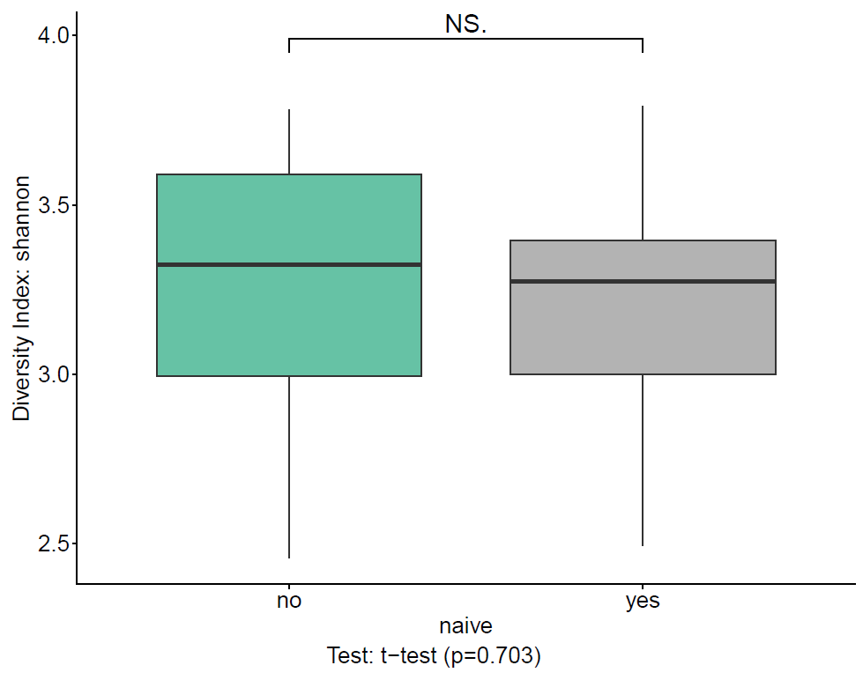
Alpha diversity (Shannon index)
Analysis of microbial diversity considering unique IDs as subset and naïve status as variable. Comparison between naïve yes and no groups shows no significant difference (t-test, p = 0.703).

Slide 7
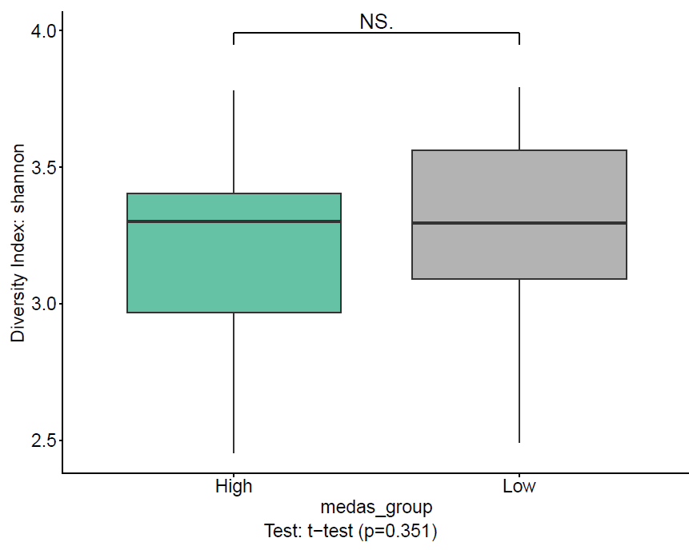
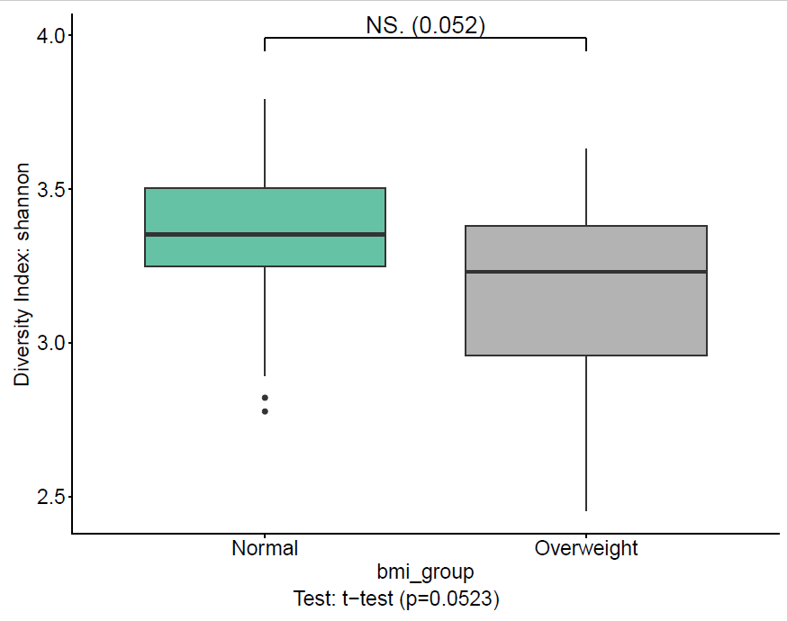
Analysis of microbial diversity considering unique IDs as subset and evaluating two variables:
Mediterranean diet adherence (medas_group) — comparison between High and Low adherence shows no significant difference (t-test, p = 0.351).
Body mass index (bmi_group) — comparison between Normal and Overweight groups shows a trend toward lower diversity in overweight subjects, though not statistically significant (t-test, p = 0.0523).
Both dietary adherence and BMI show non‑significant effects on alpha diversity, but the BMI comparison suggests a borderline trend worth exploring in larger cohorts.

Slide 8
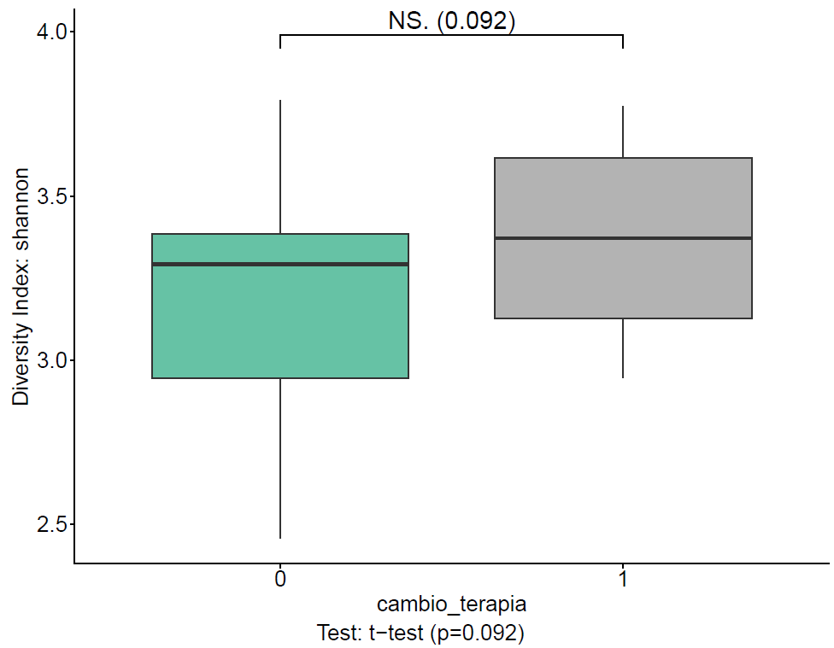
Alpha diversity (Shannon index)
Analysis of microbial diversity considering unique IDs as subset and therapy change (cambio_terapia) as variable. Comparison between groups 0 (no change) and 1 (therapy change) shows a non‑significant trend toward higher diversity after therapy modification (t-test, p = 0.092).

Slide 9
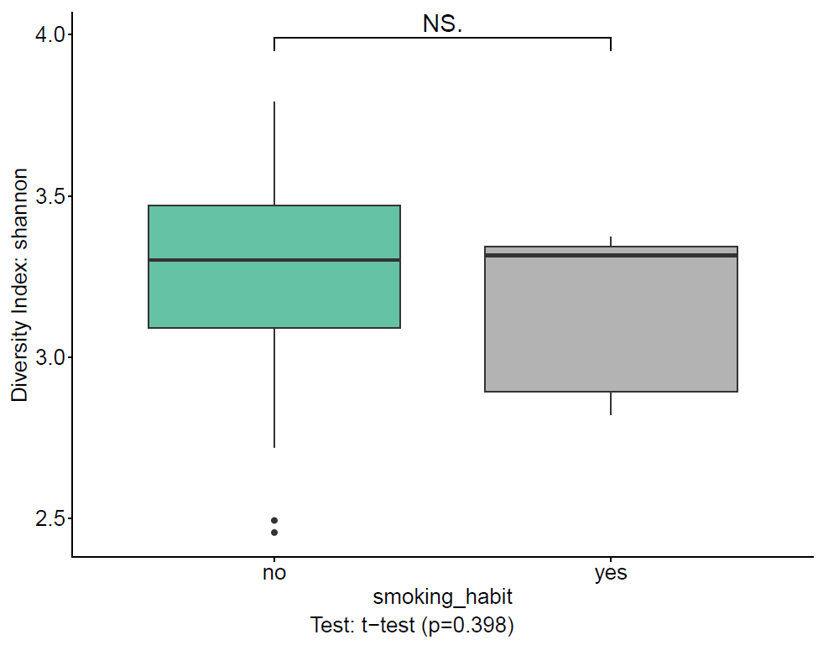
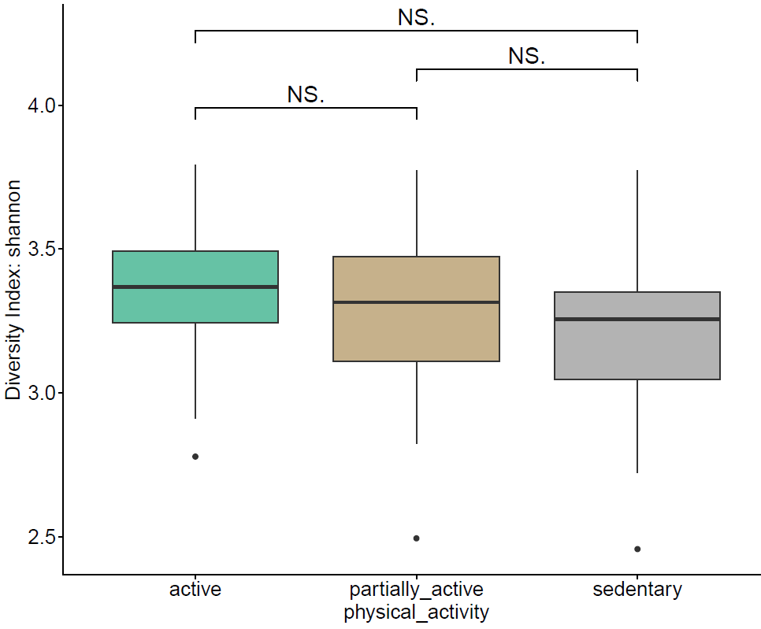
Alpha diversity (Shannon index)
Analysis of microbial diversity considering unique IDs as subset and evaluating two lifestyle variables:
Smoking habit: comparison between smokers and non‑smokers shows no significant difference (t-test, p = 0.398).
Physical activity: comparison among active, partially active, and sedentary groups shows no significant differences across categories.

Slide 10
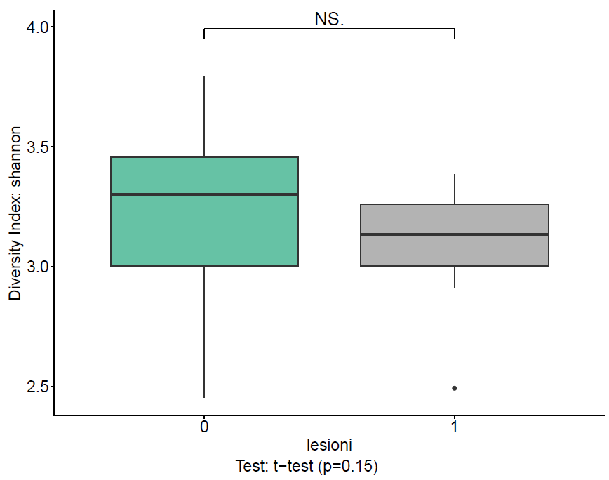
Alpha diversity (Shannon index)
Analysis of microbial diversity considering unique IDs as subset and presence of lesions (lesioni) as variable. Comparison between groups 0 (no lesions) and 1 (lesions) shows no significant difference (t-test, p = 0.15).
Although not statistically significant, the group with lesions tends to show a slightly lower median diversity, suggesting a possible trend that could be explored with a larger sample size

Slide 11
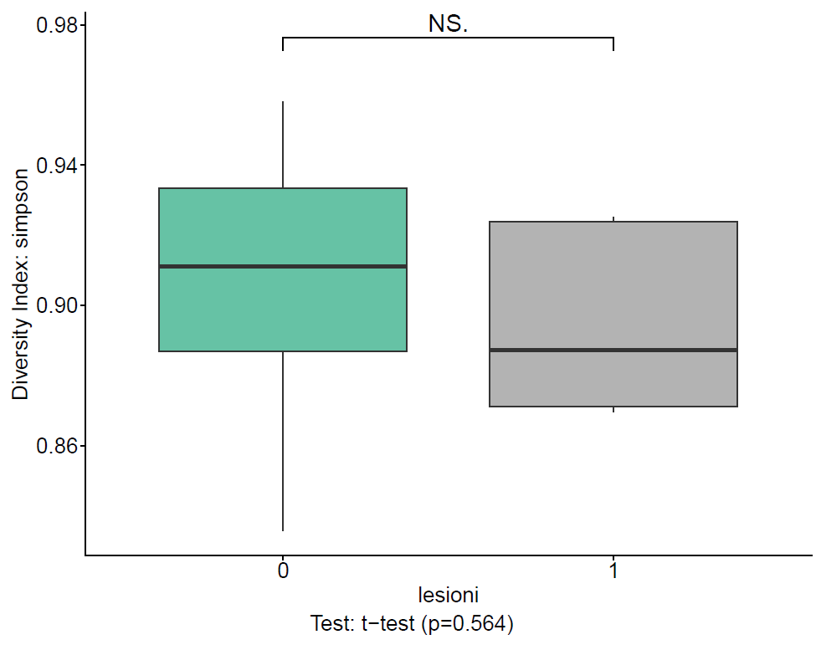
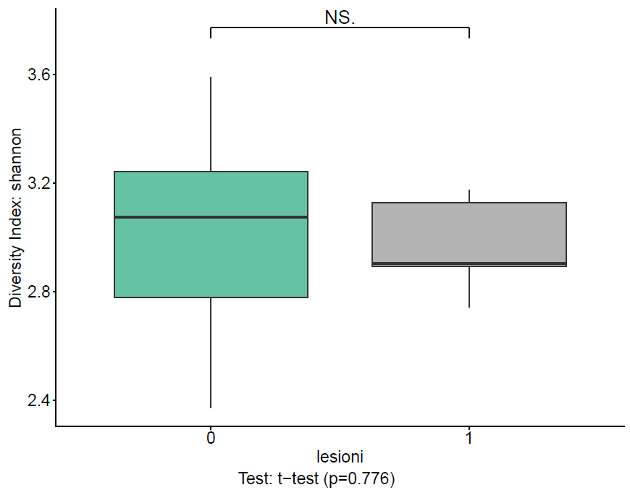
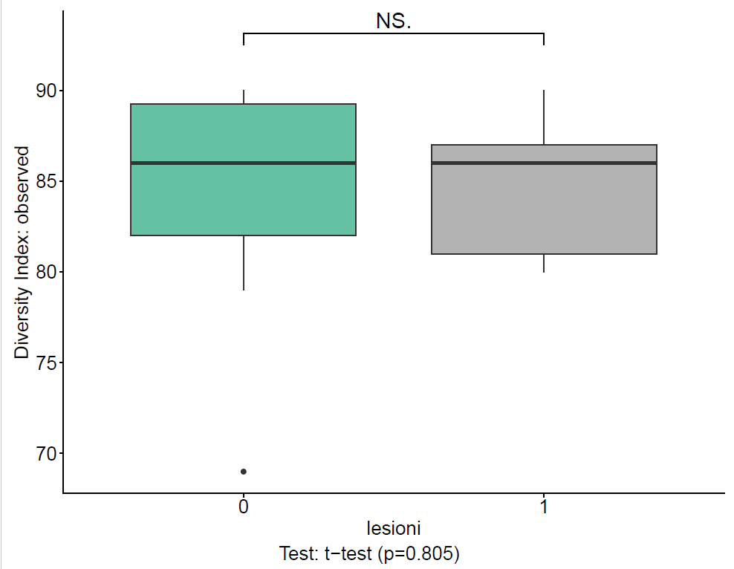
Alpha diversity at baseline
Comparison of microbial diversity indices between subjects with (1) and without (0) lesions at baseline. Across all indices — Simpson, Shannon, and Observed species richness — results show no significant differences (t-test, p = 0.564, 0.776, and 0.805 respectively).
At the start of follow‑up, microbial diversity appears stable regardless of lesion presence, suggesting that lesion status does not influence baseline community composition.

Slide 12
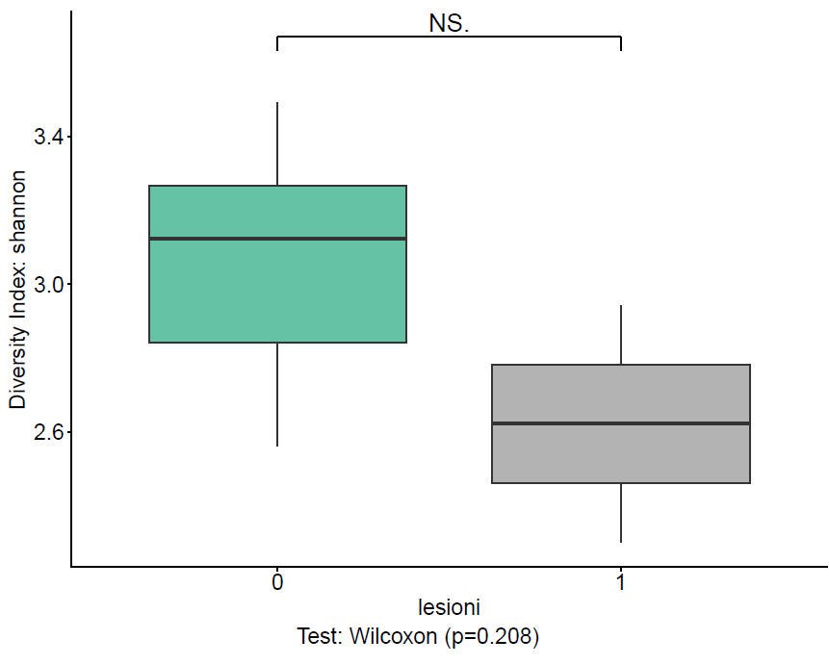
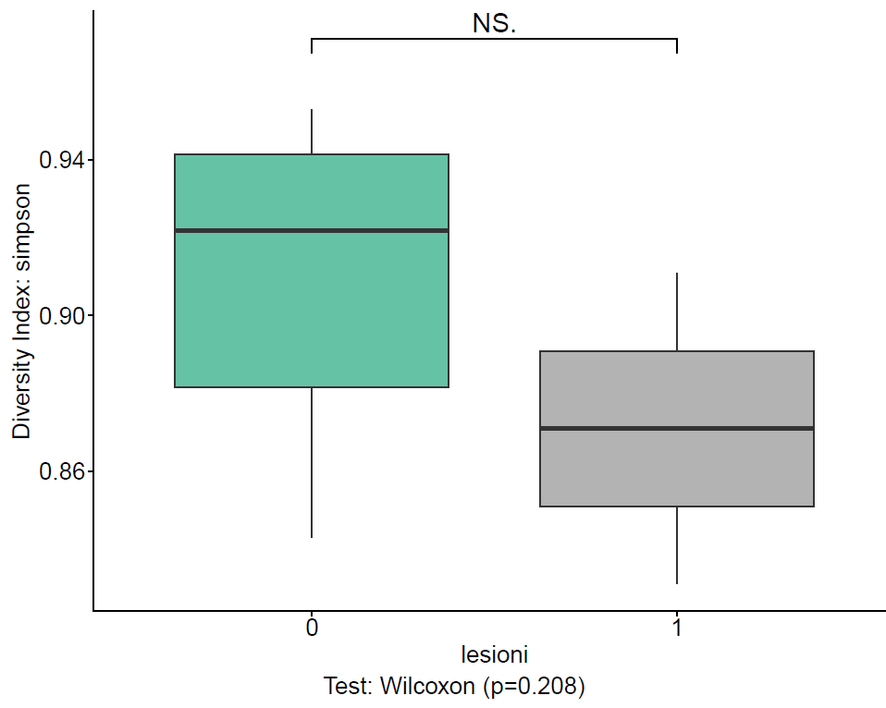
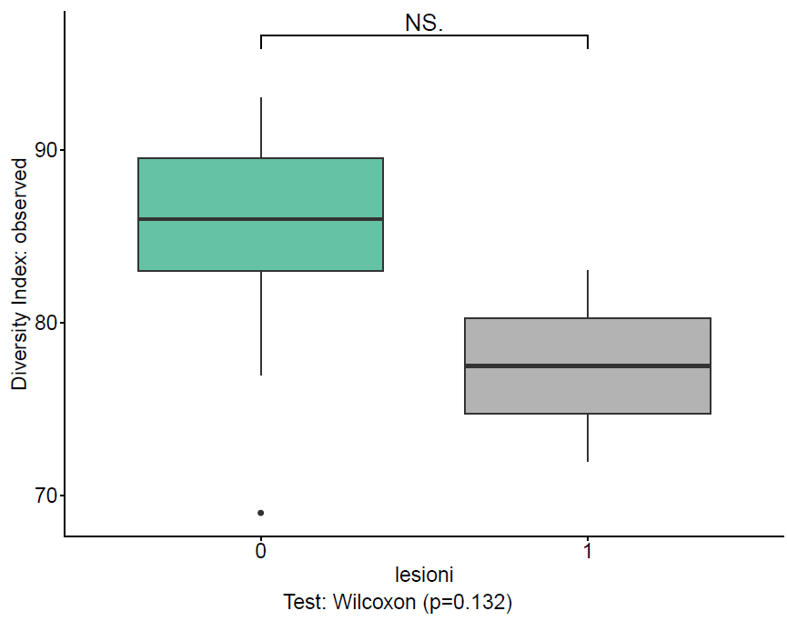
Alpha diversity at follow‑up time T1 (lesions)
Comparison of microbial diversity indices between subjects with (1) and without (0) lesions at follow‑up time T1. Across all indices — Shannon, Simpson, and Observed species richness — results show no significant differences (Wilcoxon test, p = 0.208, 0.208, and 0.132 respectively).
At T1, microbial diversity remains comparable between groups, suggesting that lesion development does not correspond to measurable shifts in community diversity over time.

Slide 13
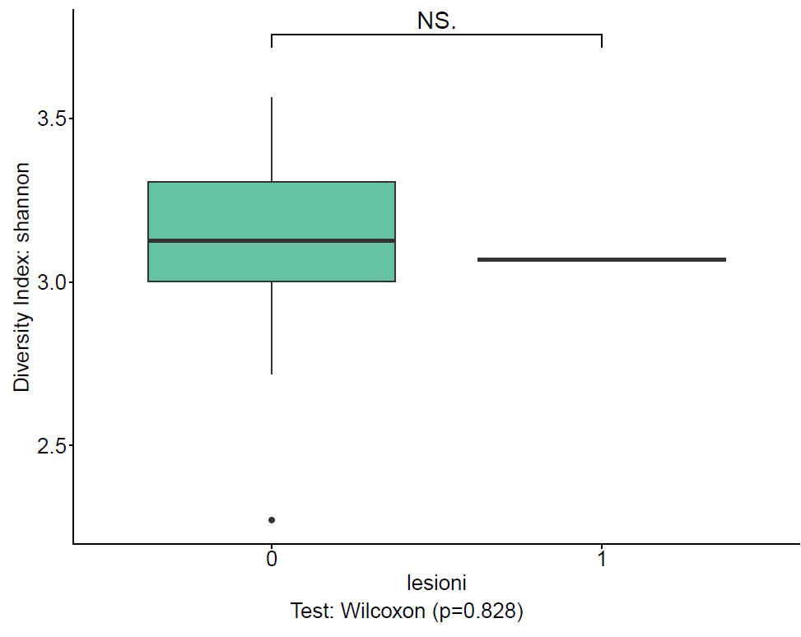
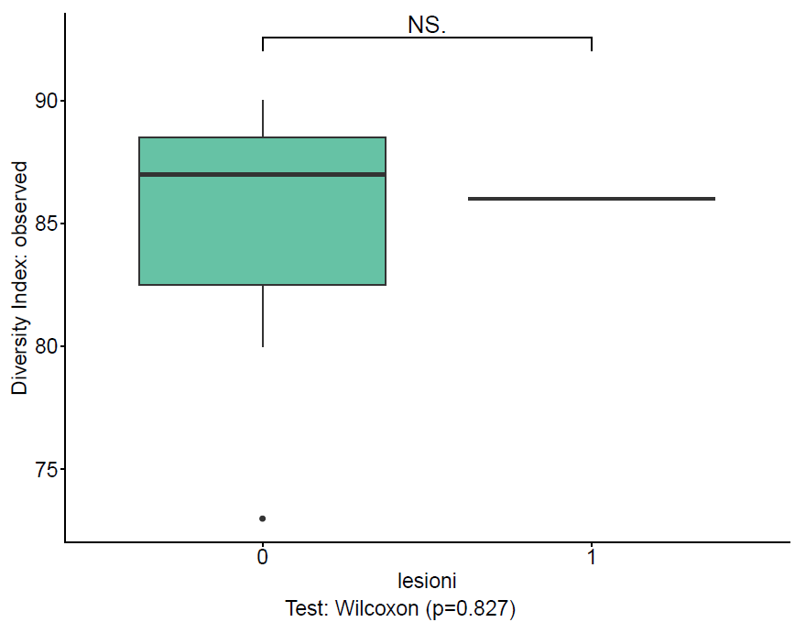
Alpha diversity at follow‑up time T12 (lesions)
Comparison of microbial diversity indices between subjects with (1) and without (0) lesions at follow‑up time T12. Results for Shannon, Simpson, and Observed species richness show no significant differences (Wilcoxon test, p = 0.828, 0.828, and 0.827 respectively), with similar trends across indices.
At T12, microbial diversity remains stable and comparable between groups, confirming that lesion presence does not correspond to measurable changes in community diversity over time.

Slide 14
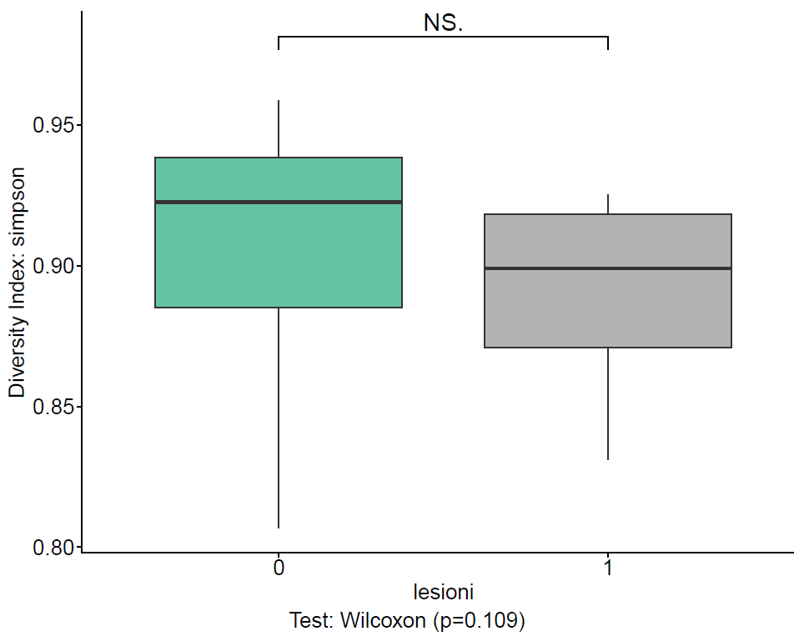
Alpha diversity (Simpson index) across all follow‑up times (T0, T1, T12)
Analysis of microbial diversity considering lesion presence (0 = absent, 1 = present) across all time points. Results show no significant difference between groups (Wilcoxon test, p = 0.109), indicating that lesion occurrence over time does not affect overall diversity.
When pooling all time points, the Simpson index remains stable between subjects with and without lesions, suggesting that temporal lesion dynamics are not associated with major shifts in microbial community structure.

Slide 15
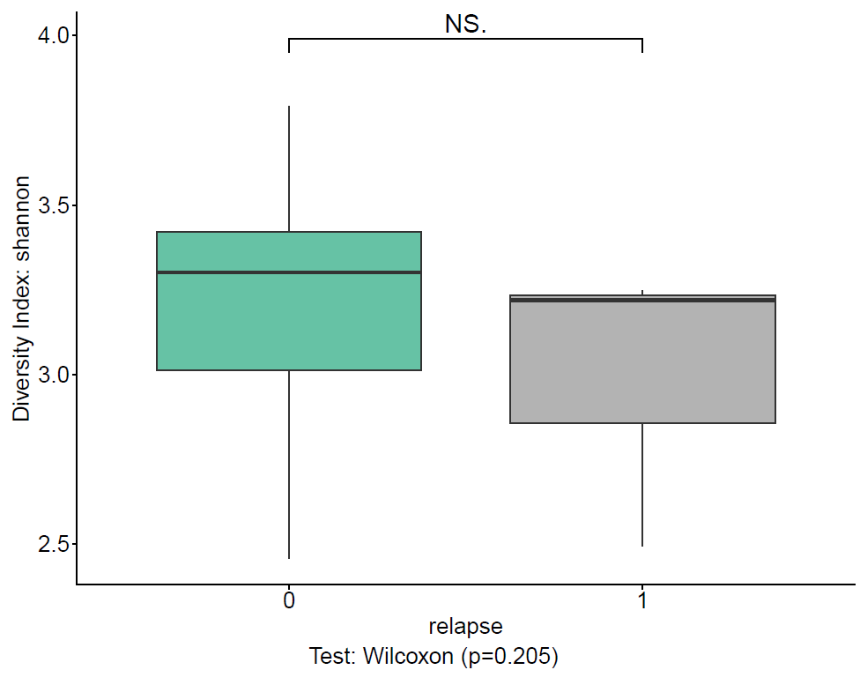
Alpha diversity (Shannon index)
Analysis of microbial diversity considering unique IDs as subset and relapse status (0 = no relapse, 1 = relapse) as variable. Results show no significant difference between groups (Wilcoxon test, p = 0.205), indicating that the occurrence of relapse is not associated with changes in microbial diversity.
The Shannon index remains stable across relapse conditions, suggesting that clinical relapse does not correspond to measurable shifts in overall microbiota diversity.

Slide 16
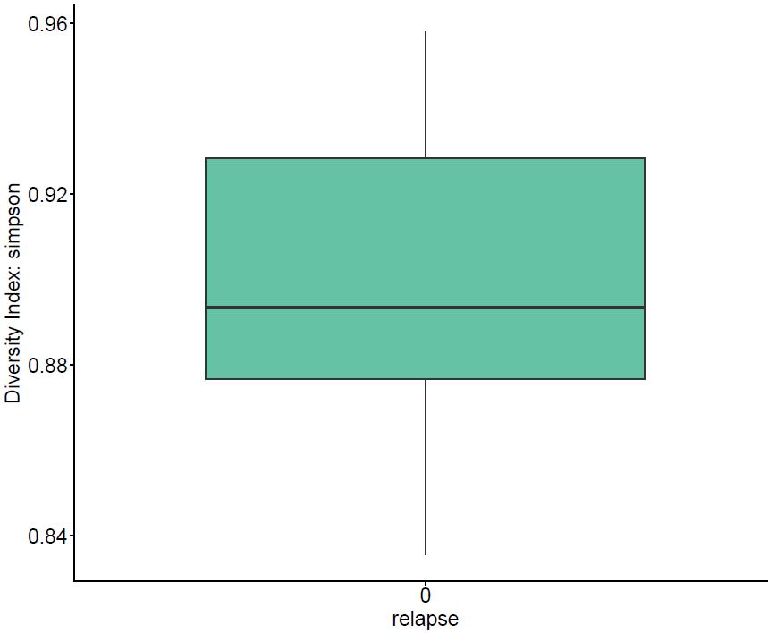
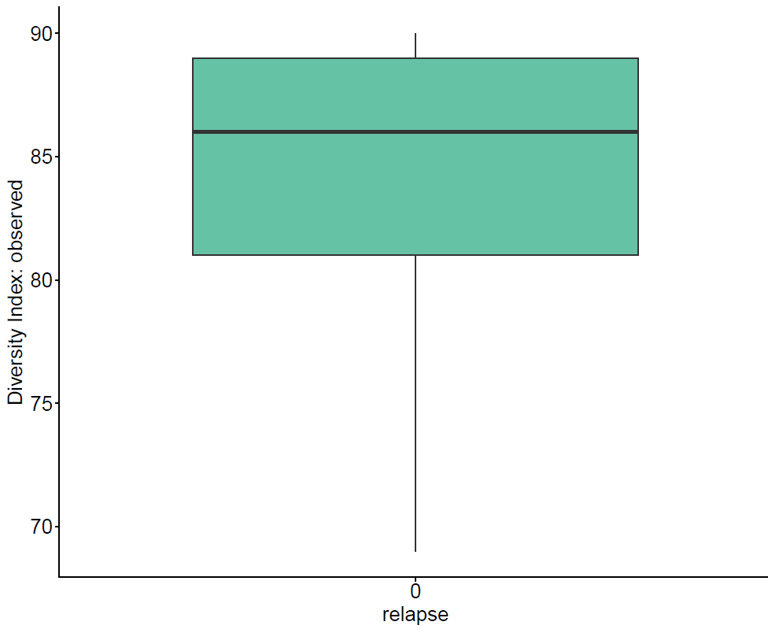
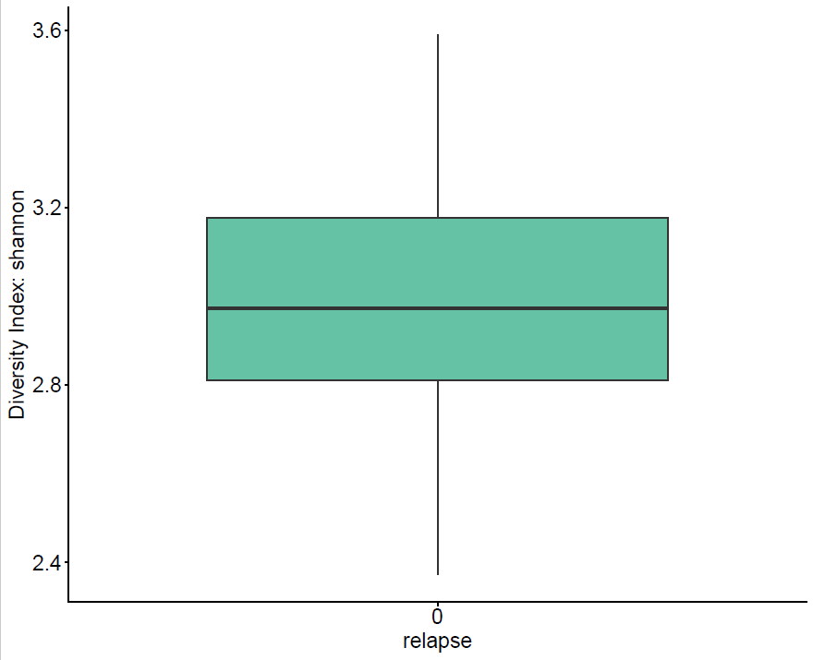
Alpha diversity at baseline (T0) by relapse status
Comparison of microbial diversity indices — Shannon, Simpson, and Observed species richness — between subjects with (1) and without (0) relapse at baseline. All indices show similar distributions and no significant differences, indicating that microbial diversity at T0 is not associated with relapse occurrence.
At baseline, the microbiota composition appears comparable across relapse conditions, suggesting that initial diversity does not predict relapse risk.

Slide 17
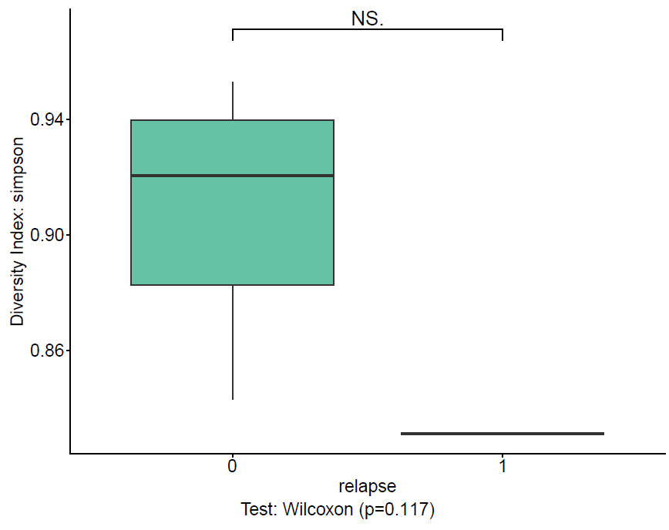
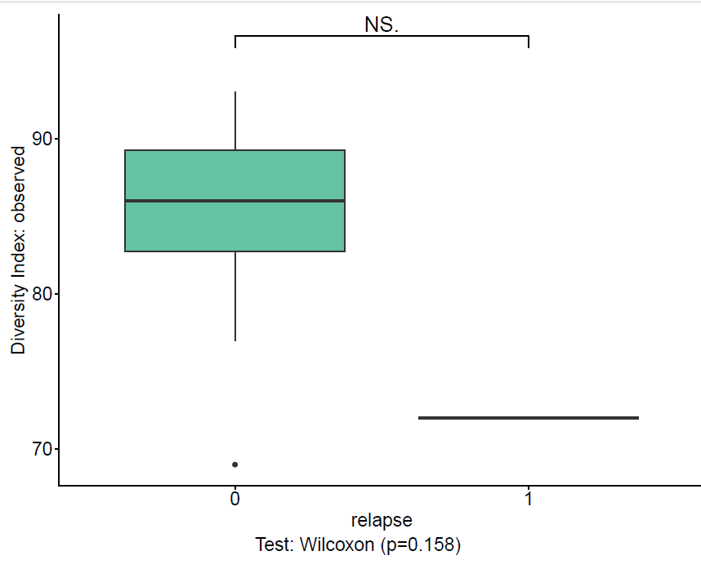
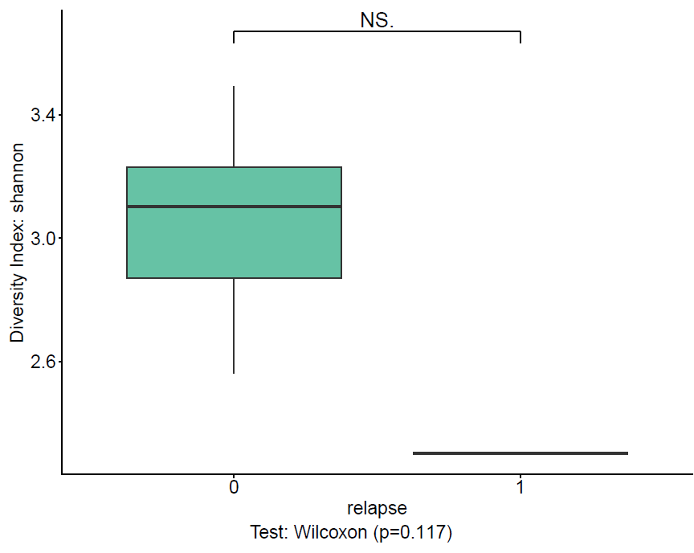
Alpha diversity at follow‑up time T1 by relapse status
Comparison of microbial diversity indices — Shannon, Simpson, and Observed species richness — between subjects with (1) and without (0) relapse at follow‑up time T1. All indices show no significant differences (Wilcoxon test, p = 0.117, 0.117, and 0.158 respectively), indicating that microbial diversity remains stable regardless of relapse occurrence.
At T1, the microbiota composition appears unchanged between relapse and non‑relapse groups, suggesting that diversity does not fluctuate in relation to clinical relapse events.

Slide 18
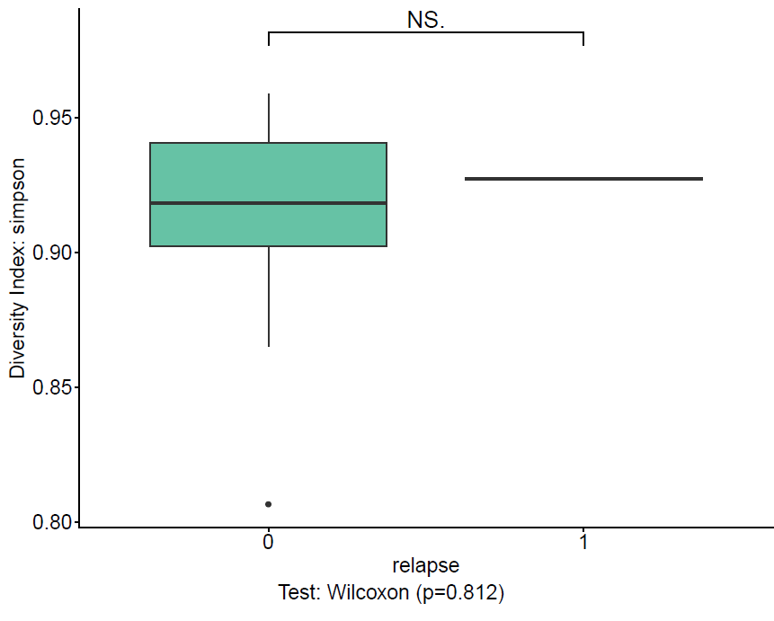
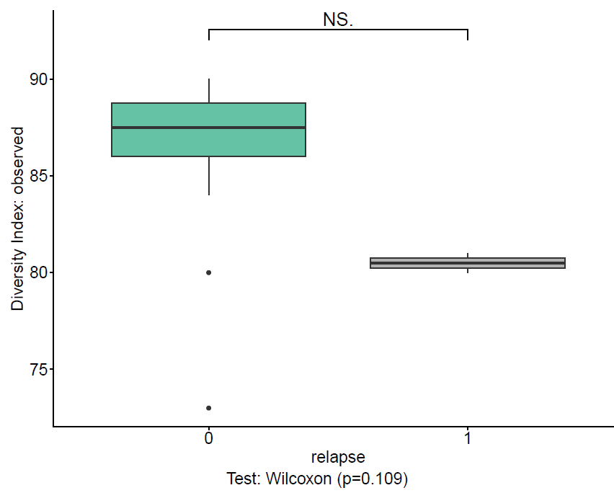
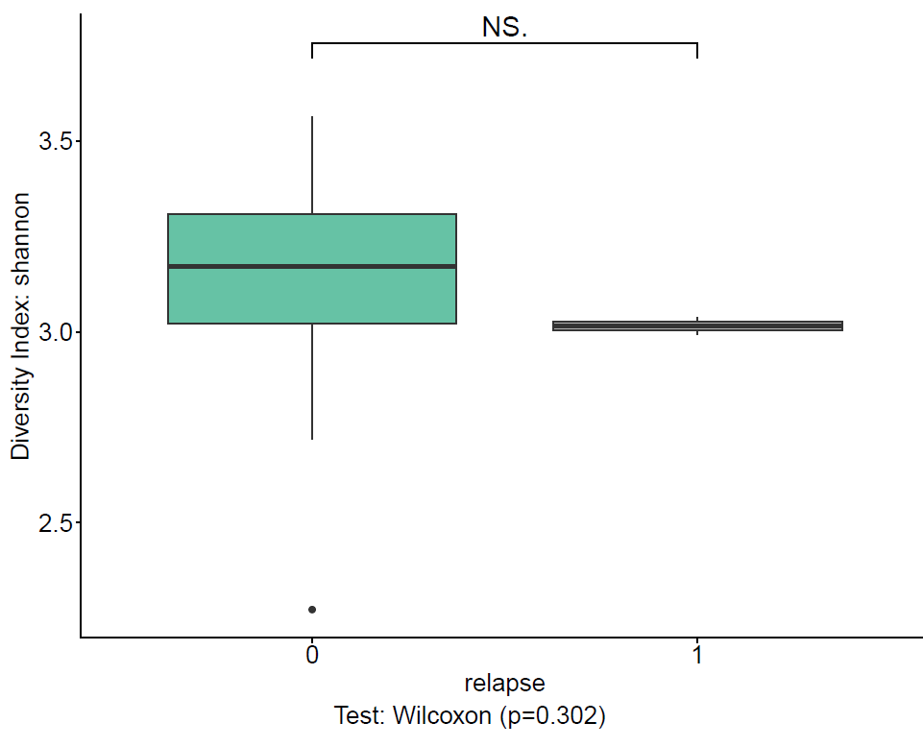
Alpha diversity at follow‑up time T12 by relapse status
Comparison of microbial diversity indices — Shannon, Simpson, and Observed species richness — between subjects with (1) and without (0) relapse at follow‑up time T12. All indices show no significant differences (Wilcoxon test, p = 0.302, 0.812, and 0.109 respectively), indicating that microbial diversity remains stable regardless of relapse occurrence.
At T12, the microbiota composition appears unchanged between relapse and non‑relapse groups, confirming that diversity does not fluctuate in relation to clinical relapse events over time.

Slide 19
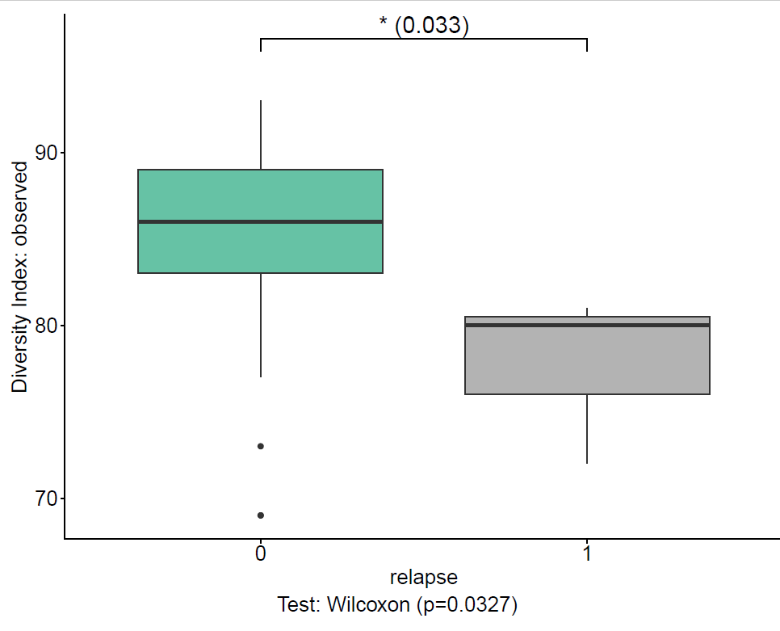
Alpha diversity (Observed species richness) across all follow‑up times (T0, T1, T12)
Analysis of microbial diversity considering relapse status (0 = no relapse, 1 = relapse) across all time points. Results show a significant reduction in observed species richness among subjects with relapse (Wilcoxon test, p = 0.0327), indicating that relapse events are associated with lower microbial diversity over time.
When pooling all time points, individuals experiencing relapse display reduced richness, suggesting that loss of microbial diversity may accompany or precede clinical relapse

Slide 20
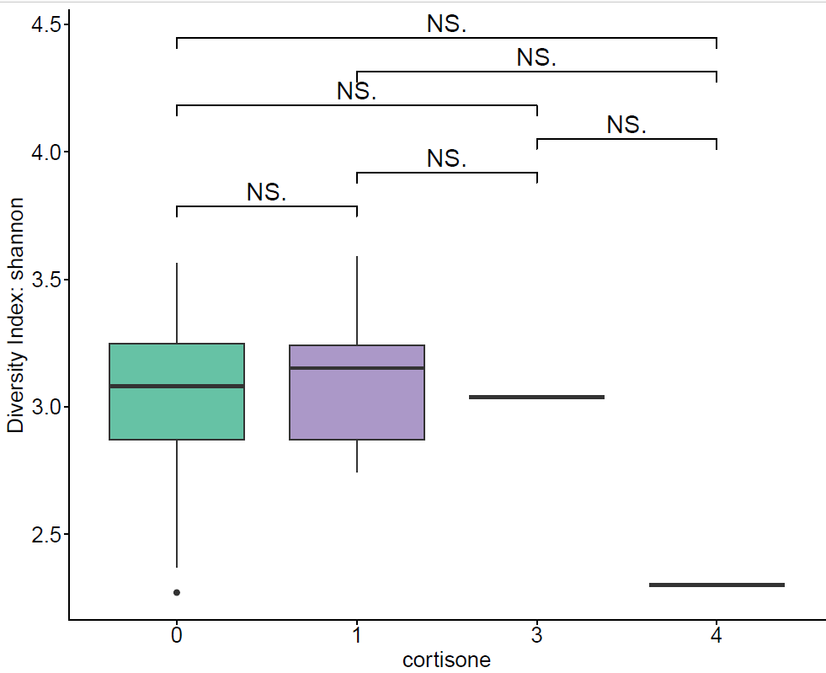
Alpha diversity (Shannon index) by cortisone use
Analysis of microbial diversity considering patients as subset and cortisone use as variable (0, 1, 3, 4 = number of administrations). Across all categories, no significant differences were observed (NS for all pairwise comparisons), indicating that cortisone treatment does not significantly affect microbial diversity in this dataset.
Despite slight variability in median values — with lower diversity at higher cortisone counts — the absence of statistical significance suggests that episodic cortisone use has minimal impact on overall microbiota composition.

Slide 21
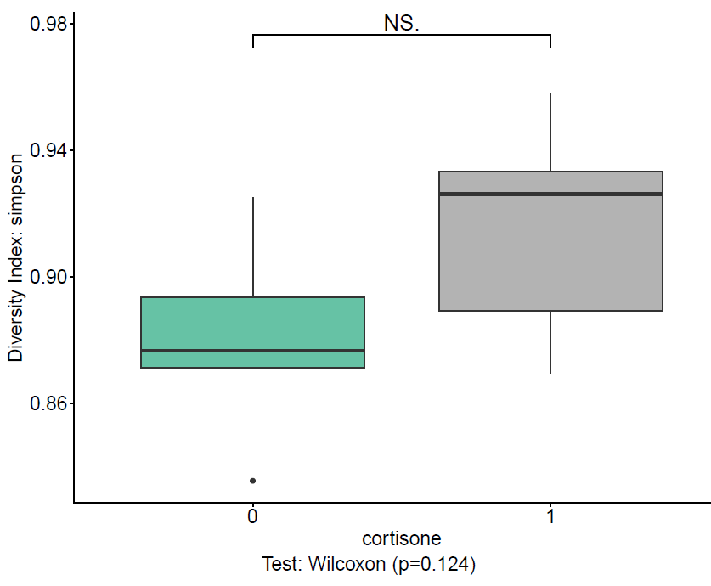
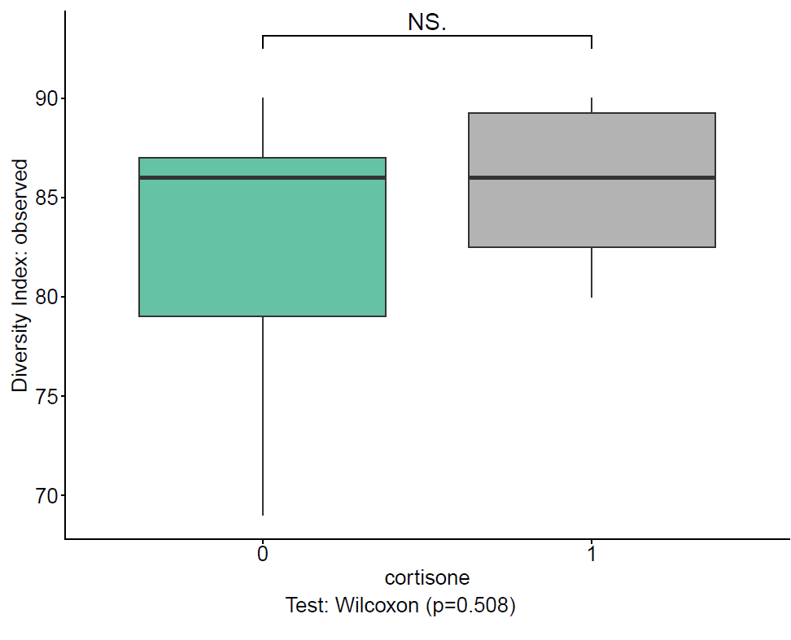
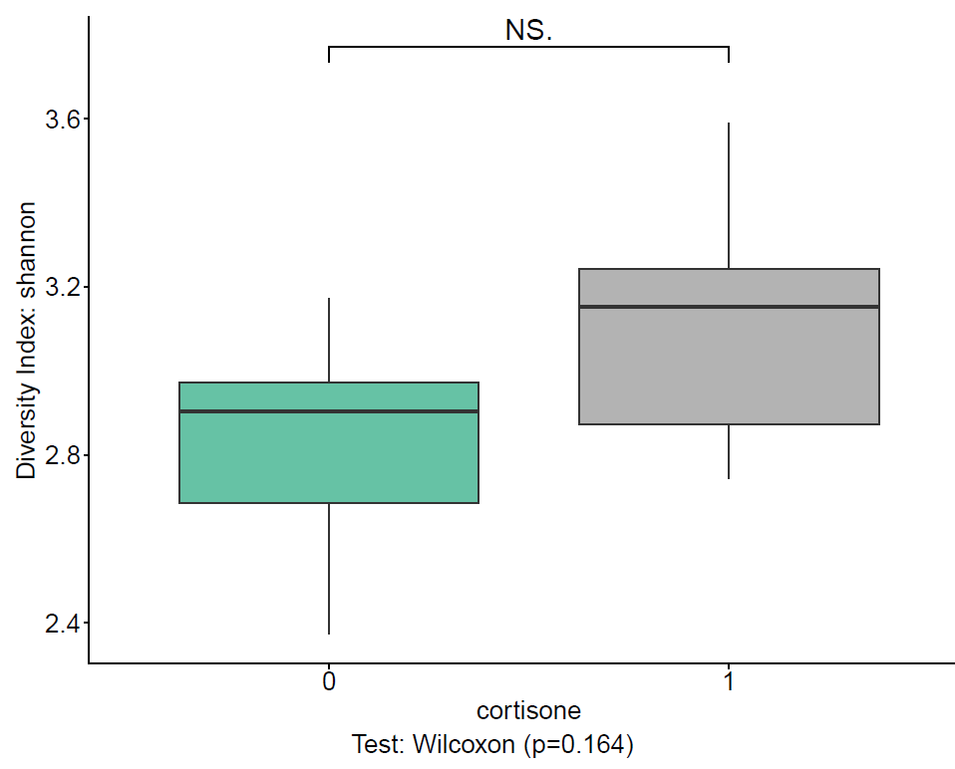
Alpha diversity at baseline (T0) by cortisone use
Comparison of microbial diversity indices — Shannon, Simpson, and Observed species richness — between subjects with (1) and without (0) cortisone use at baseline. All indices show no significant differences (Wilcoxon test, p = 0.164, 0.124, and 0.508 respectively), indicating that cortisone administration does not significantly affect microbial diversity. Results at T1 were identical, confirming the stability of diversity measures across time points.
Both at baseline and T1, the microbiota composition remains consistent regardless of cortisone use, suggesting that short‑term corticosteroid exposure does not alter overall community diversity.

Slide 22
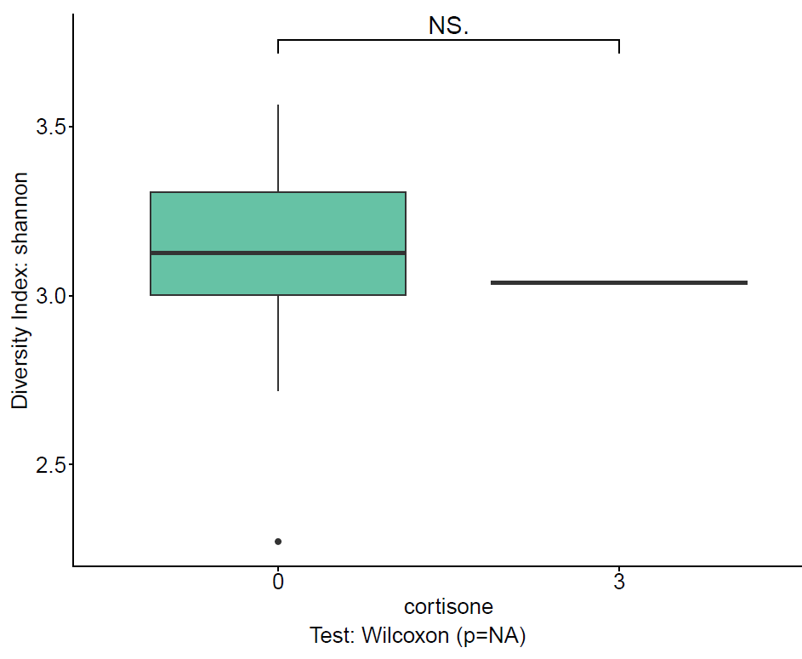

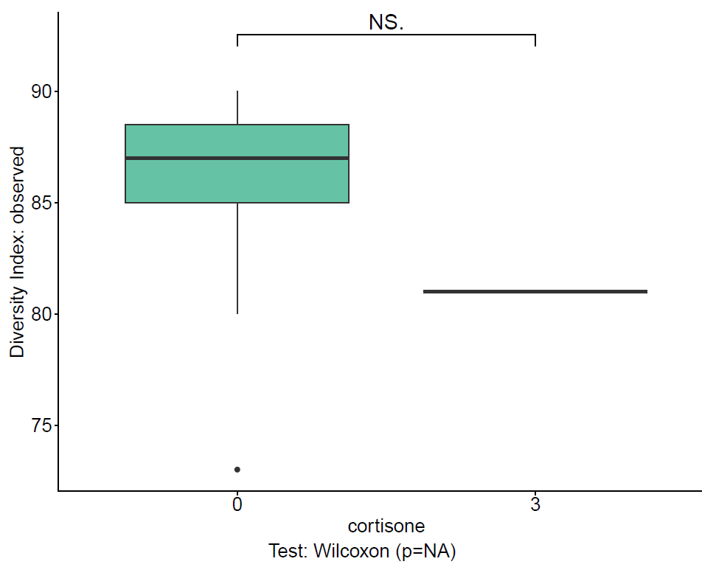
Alpha diversity at follow‑up time T12 by cortisone use
Comparison of microbial diversity indices — Shannon, Simpson, and Observed species richness — between subjects with (3) and without (0) cortisone use at follow‑up time T12. All indices show no significant differences (Wilcoxon test, p = NA), indicating that the limited sample size or data distribution prevented statistical evaluation, but overall no trend toward altered diversity was observed.
At T12, the microbiota composition appears stable regardless of cortisone use, and the p = NA result likely reflects insufficient data points rather than a biological effect.

Slide 23
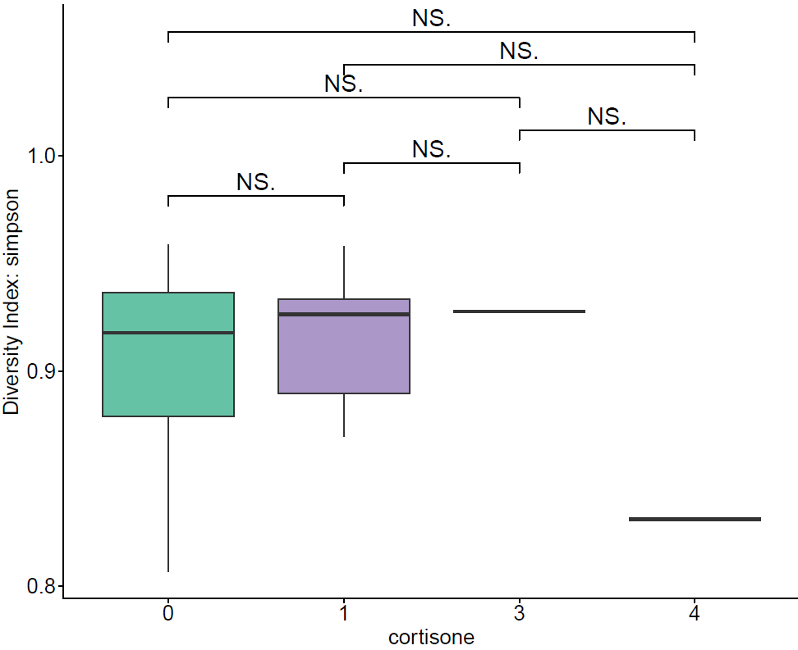
Alpha diversity (Simpson index) by cortisone use over time
Analysis of microbial diversity considering patients as subset and cortisone use as variable across all time points. All pairwise comparisons are not significant, indicating that episodic cortisone administration — typically prescribed in response to clinical worsening or relapse — does not significantly alter microbial diversity.
Cortisone is used as needed, not as a continuous therapy. The absence of significant differences across time suggests that short‑term corticosteroid interventions have minimal impact on overall microbiota composition, supporting their role as temporary anti‑inflammatory measures rather than long‑term modulators of diversity.

Slide 24
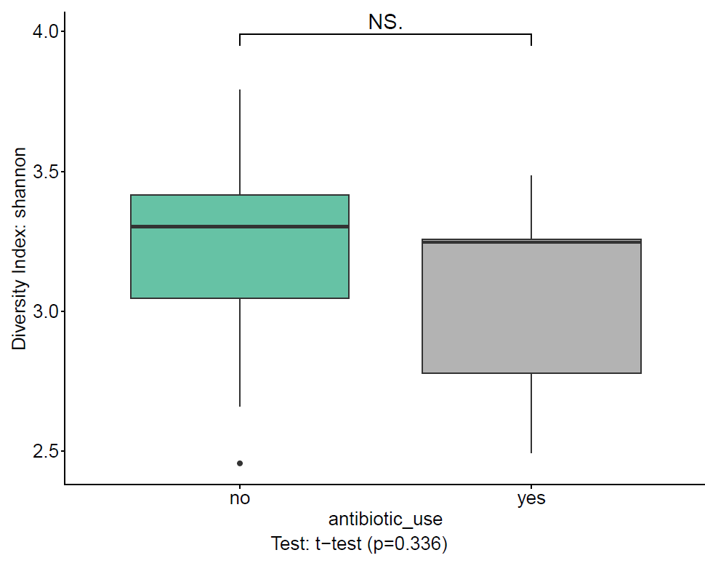
Alpha diversity (Shannon index) by antibiotic use at therapy initiation
Analysis of microbial diversity considering patients as subset and antibiotic use (yes/no) as variable at the start of therapy. Results show no significant difference between groups (t-test, p = 0.336), indicating that previous antibiotic exposure does not significantly affect baseline microbial diversity.
At therapy initiation, the microbiota composition appears comparable between antibiotic users and non‑users, suggesting that recent antibiotic use did not lead to persistent diversity reduction in this cohort.

Slide 25
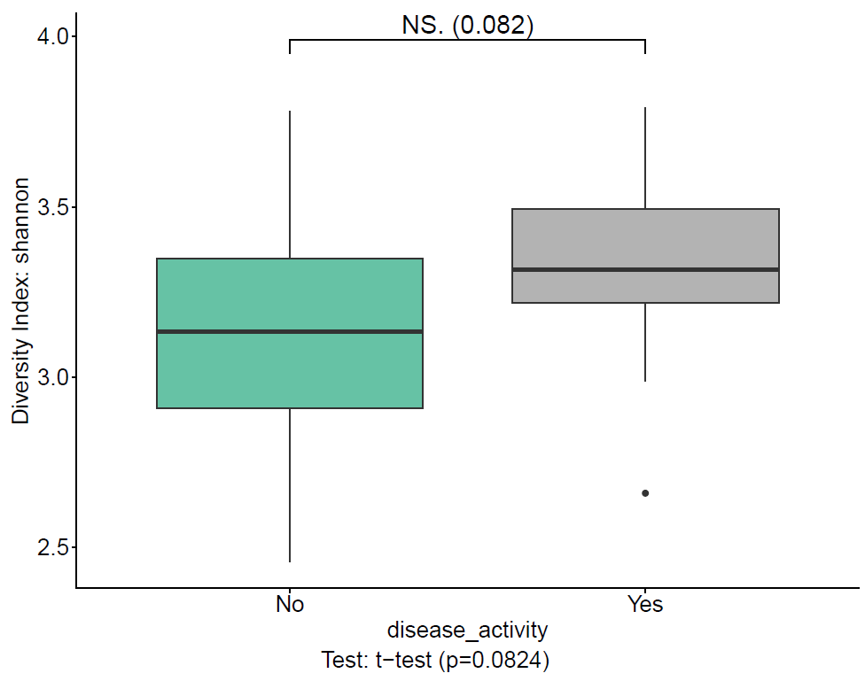
Alpha diversity (Shannon index) by disease activity at therapy initiation
Analysis of microbial diversity considering patients as subset and disease activity (Yes/No) as variable at the start of therapy. Results show no significant difference between groups (t-test, p = 0.0824), although a slight trend toward higher diversity is observed in patients with active disease.
At baseline, microbial diversity appears comparable between active and inactive disease states, suggesting that initial disease activity does not strongly influence overall microbiota composition, though the mild upward trend in active cases could warrant further investigation.

Slide 26
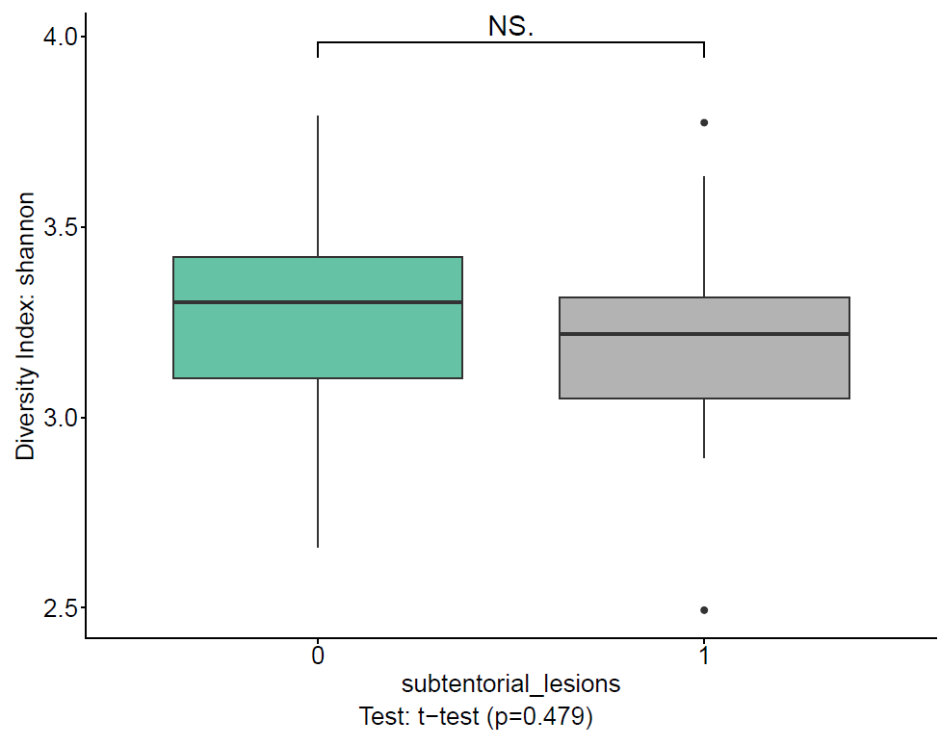
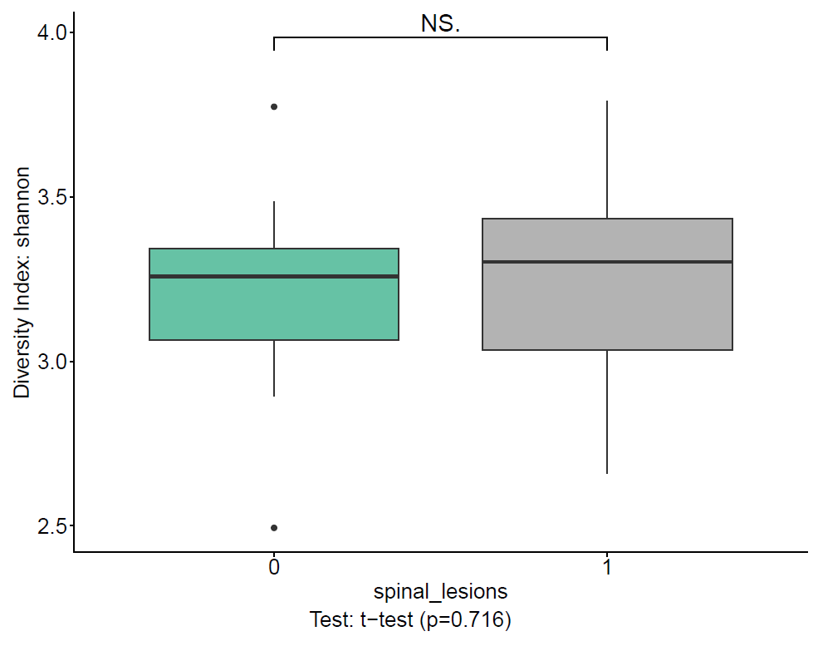
Alpha diversity (Shannon index) at baseline (T0) by lesion location
Comparison of microbial diversity between subjects with (1) and without (0) lesions in two anatomical regions: subtentorial (left panel) and spinal (right panel). Both analyses show no significant differences (t-test, p = 0.479 and p = 0.716 respectively), indicating that the presence of subtentorial or spinal lesions at baseline does not influence microbial diversity.
At therapy initiation, microbial diversity remains consistent across lesion locations, suggesting that lesion distribution within the CNS is not associated with baseline microbiota composition.

Slide 27
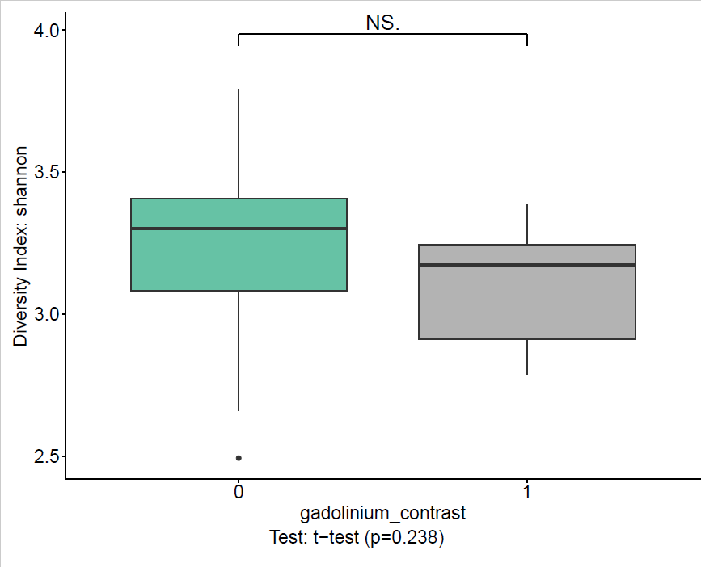
Alpha diversity (Shannon index) at baseline (T0) by gadolinium contrast use
Comparison of microbial diversity between subjects with (1) and without (0) gadolinium contrast administration at baseline. Results show no significant difference (t-test, p = 0.238), indicating that the use of gadolinium contrast does not influence microbial diversity at the start of therapy.
At T0, the microbiota composition appears similar between patients who received gadolinium and those who did not, suggesting that contrast use — typically reflecting disease activity — is not associated with baseline diversity changes.

Slide 28
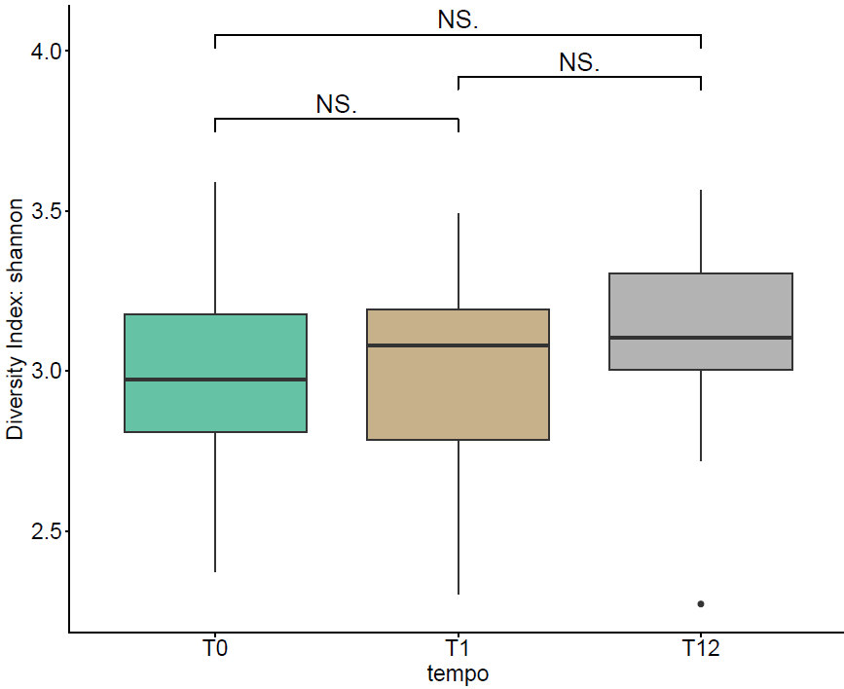
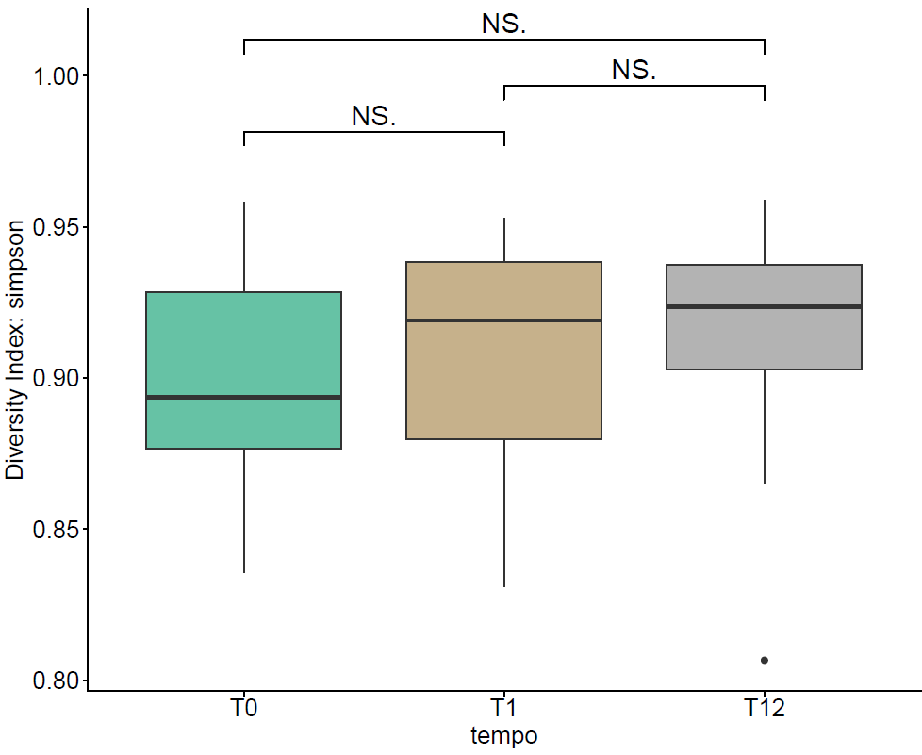
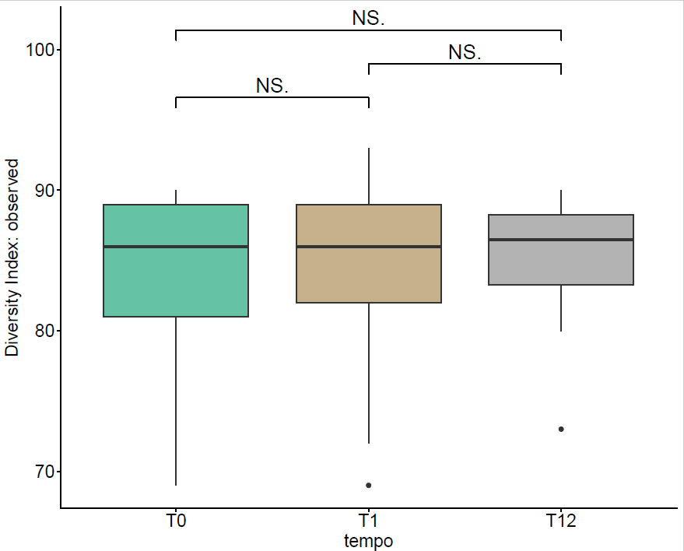
Alpha diversity over time (T0, T1, T12)
Comparison of microbial diversity indices — Shannon, Simpson, and Observed species richness — across all time points using timepoints as subset. All indices show no significant differences (NS for all pairwise comparisons), indicating that microbial diversity remains stable throughout the study period.
Across T0, T1, and T12, the microbiota composition appears consistent, suggesting that therapy and disease progression do not significantly impact overall diversity over time.

Slide 29
Interpretation
Microbial diversity does not significantly differ across clinical groups. The microbiota appears stable, with no marked dysbiosis associated with the variables analyzed.
No significant changes in diversity across timepoints.
Exception: Relapse across all follow‑up times

Slide 30
Beta Diversity: Key Concepts
Based on distance matrices (Bray‑Curtis, Jaccard). PCoA visualizes clustering or overlap.
Beta diversity measures how different microbiota profiles are across samples.
Analysis of microbial community composition using Bray–Curtis dissimilarity and PCoA visualization.

Slide 31
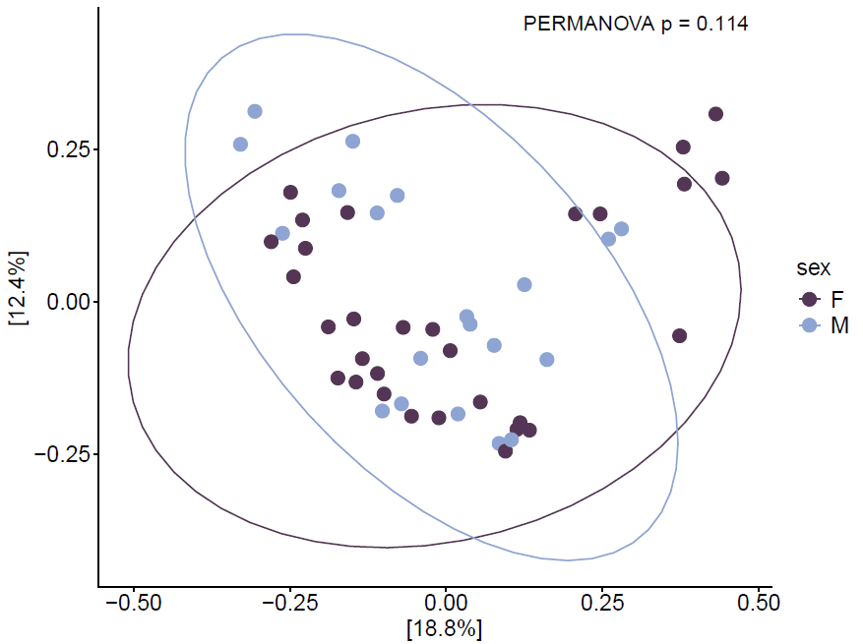
Beta diversity by sex
Samples are grouped by sex (F vs M), showing overlapping clusters and no significant separation (PERMANOVA, p = 0.114). This indicates that microbiota composition does not differ significantly between male and female subjects.
The elliptical overlap highlights that intra‑group variability exceeds inter‑group differences, suggesting sex has minimal influence on overall microbial structure.

Slide 32
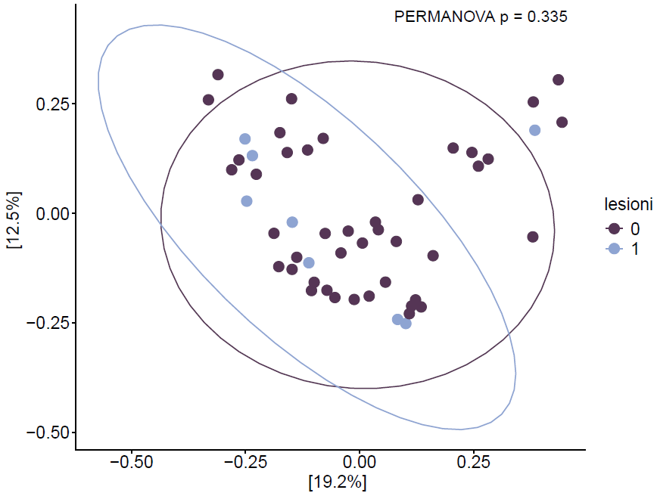
Beta diversity by lesion presence during follow‑up
Samples are grouped by presence (1) or absence (0) of lesions, showing overlapping clusters and no significant separation (PERMANOVA, p = 0.335). This indicates that lesion occurrence during follow‑up does not significantly influence overall microbiota composition.
The consistent overlap between groups suggests that microbial community structure remains stable over time, regardless of lesion development or progression.

Slide 33
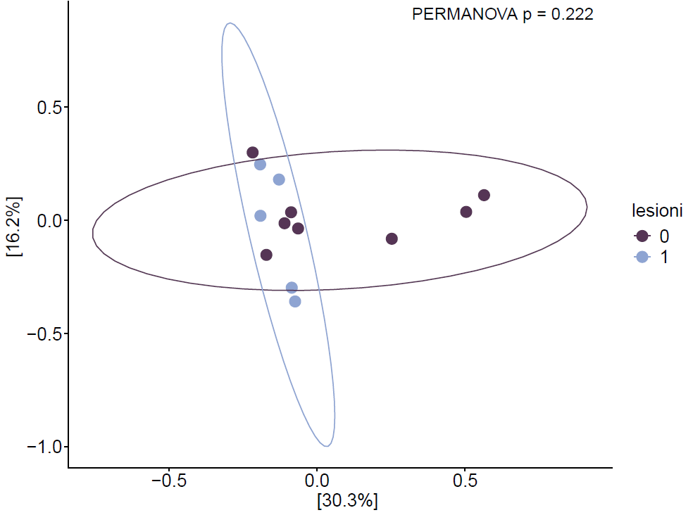
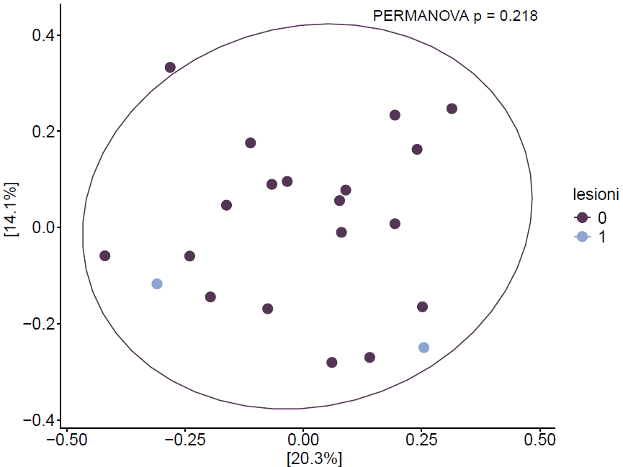
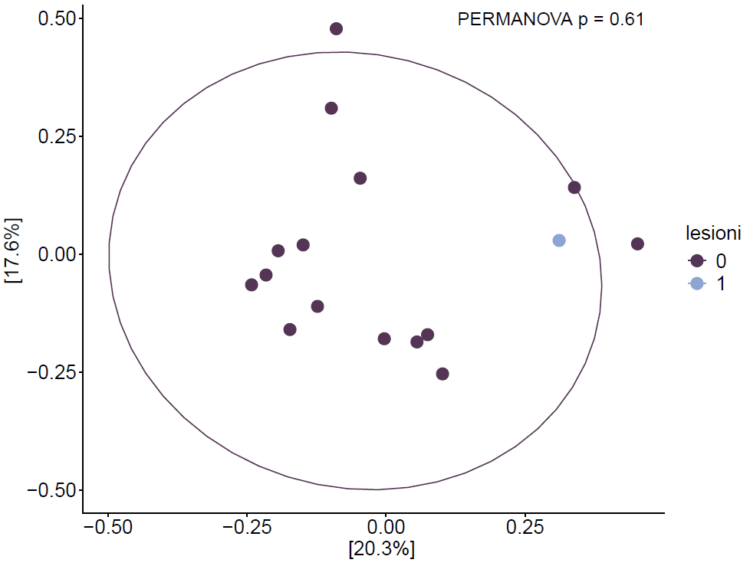
Beta diversity by lesion presence across time points (T0, T1, T12)
Samples are grouped by presence (1) or absence (0) of lesions, showing overlapping clusters and no significant separation (PERMANOVA, p = 0.222, 0.218, and 0.61 respectively). These results indicate that lesion presence does not significantly influence microbiota composition over time.

Slide 34
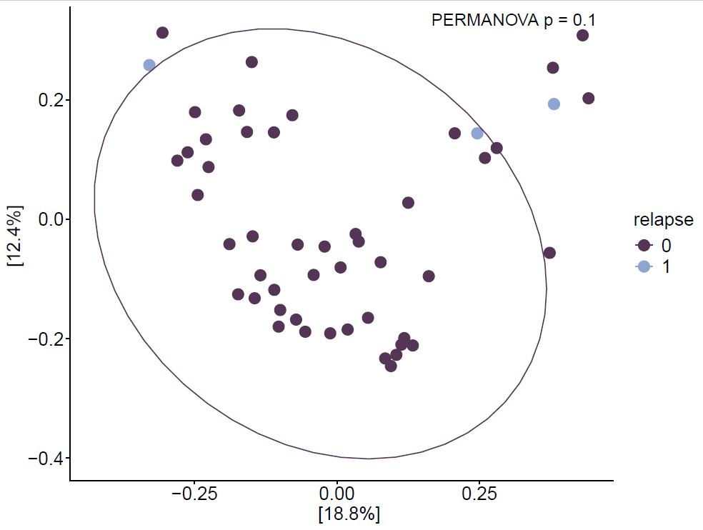
Beta diversity by relapse occurrence during follow‑up
Samples are grouped by relapse status (0 = no relapse, 1 = relapse), showing overlapping clusters and no significant separation (PERMANOVA, p = 0.1). This indicates that relapse events are not associated with significant changes in overall microbiota composition during follow‑up.
The substantial overlap between groups suggests that microbial community structure remains stable, even in patients experiencing relapse, supporting the idea that clinical recurrence does not correspond to major compositional shifts.

Slide 35
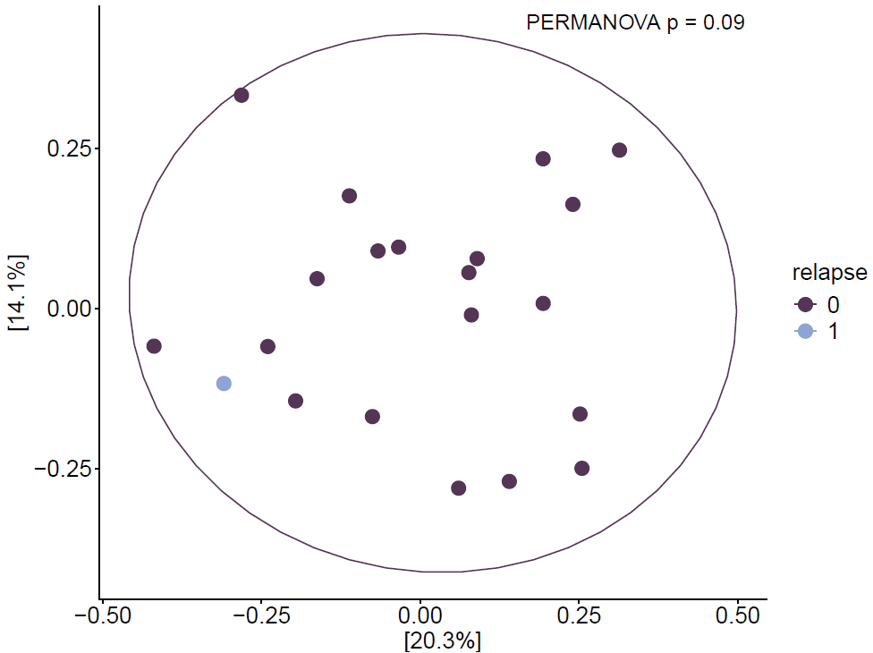
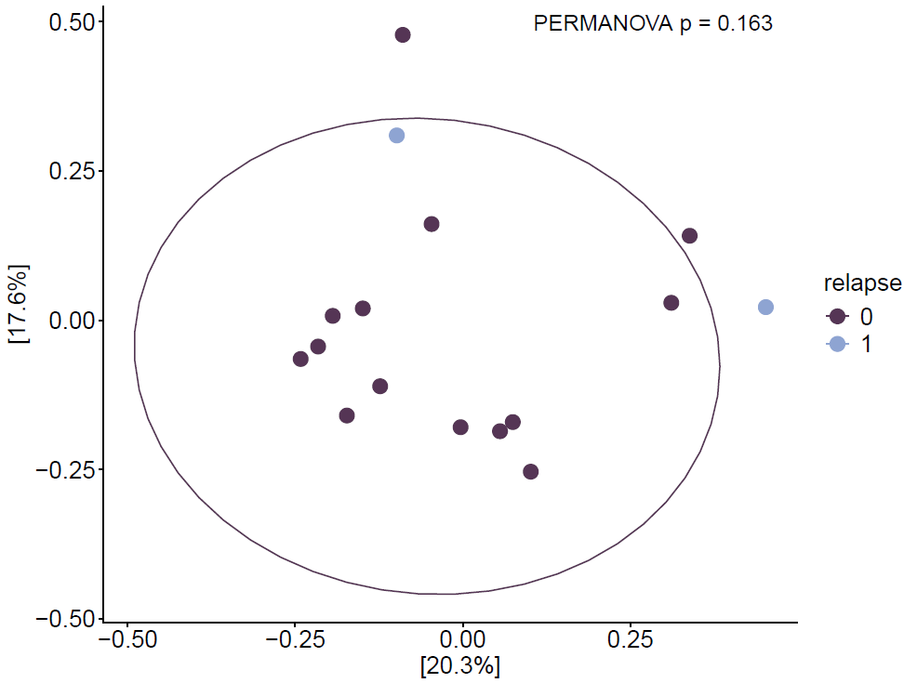
Beta diversity by relapse occurrence at T1 and T12
Samples are grouped by relapse status (0 = no relapse, 1 = relapse), showing overlapping clusters and no significant separation (PERMANOVA, p = 0.09 and p = 0.163 respectively). Beta diversity at T0 could not be calculated due to the limited number of available reports. Overall, these results indicate that relapse events do not significantly affect microbiota composition during follow‑up.

Slide 36

Beta diversity by cortisone use during follow‑up
Samples are grouped by duration of cortisone treatment (0, 1, 3, 4 days), showing overlapping clusters and no significant separation (PERMANOVA, p = 0.351). This indicates that episodic cortisone administration — typically prescribed in response to clinical worsening or relapse — does not significantly alter overall microbiota composition.
The broad overlap between groups suggests that short‑term corticosteroid use has minimal impact on microbial community structure, supporting its role as a temporary anti‑inflammatory intervention rather than a long‑term modulator of diversity.

Slide 37



Beta diversity by cortisone use at T0, T1, and T12
Samples are grouped by cortisone use (0 = no use, 1–4 = days of administration).
At T0, a slight separation is observed (PERMANOVA, p = 0.038), while T1 and T12 show no significant differences (p = 0.09 and p = 0.237 respectively).
These results indicate that short‑term cortisone administration may transiently influence microbial composition at baseline, but no sustained effect is observed during follow‑up.

Slide 38

Beta diversity by naïve status
Samples are grouped by naïve status (yes/no), showing overlapping clusters and no significant separation (PERMANOVA, p = 0.324). This indicates that prior exposure to therapy does not significantly influence overall microbiota composition at baseline.
The broad overlap between naïve and non‑naïve patients suggests that microbial community structure is comparable, supporting the idea that previous treatment history has minimal impact on baseline diversity.

Slide 39

Beta diversity by Mediterranean diet adherence (MEDAS)
Diet as a key modulator of microbiota diversity
Samples grouped by MEDAS score (High vs Low) show a significant separation (PERMANOVA, p = 0.024). This suggests that higher adherence to the Mediterranean diet is associated with distinct microbial community profiles, highlighting the impact of dietary patterns on gut microbiota structure.

Slide 40

Beta diversity by BMI group
Lifestyle factors emerge as major microbiota modulators
Beta diversity analysis based on BMI category (Normal vs Overweight) reveals a significant difference (PERMANOVA, p = 0.019). These findings indicate that body weight influences microbial community structure, suggesting a link between metabolic status and gut ecosystem balance.

Slide 41
What stacked bar plots show in microbiota analysis
Stacked bar plots represent the relative proportion of taxa (Phylum, Genus, etc.) in each sample or group. They provide an immediate visual overview of “who makes up” the microbiota and how much each microbial group contributes.
Relative abundance — each colored segment shows how much a taxon contributes to the sample.
Sample composition — the sum of all segments is 100%, representing the total microbiota composition.
Taxonomic levels — patterns can be explored at different taxonomic ranks (Phylum, Genus, etc.).

Slide 42
Stacked bar plots are essential for an initial qualitative interpretation of microbiota data because they allow us to:
Identify dominant taxa — see which microbial groups prevail across samples or conditions.
Compare composition patterns — observe qualitative differences between groups (e.g., sex, therapy, time).
Detect qualitative shifts — notice increases or decreases in relevant taxa, such as Bacteroidota or Firmicutes.
Guide quantitative analyses — this is a descriptive, not statistical, analysis: it helps identify trends to be tested with quantitative methods (e.g., differential abundance).

Slide 43

Microbiota composition by sex
The plot illustrates that the overall microbial composition is similar between female and male patients, with dominant genera such as Bacteroides, Faecalibacterium, Alistipes, and Blautia consistently present across both groups. This visualization highlights individual variability but no clear sex‑related clustering, suggesting comparable microbiota structure between sexes.

Slide 44


Slide 45

Microbiota composition by presence of lesions
The plot reveals that the overall microbial composition is similar between patients with and without lesions, with dominant genera such as Bacteroides, Faecalibacterium, Alistipes, and Blautia consistently represented in both groups.

Slide 46


Slide 47

Microbiota composition by relapse status
The plot indicates that the overall microbial composition is similar between patients with and without relapse, with dominant genera such as Bacteroides, Faecalibacterium, Alistipes, and Blautia consistently represented across both groups.

Slide 48


Slide 49

Microbiota composition by cortisone use
The plot reveals that the overall microbial composition remains similar across different levels of cortisone exposure, with dominant genera such as Bacteroides, Faecalibacterium, Alistipes, and Blautia consistently represented in all groups.

Slide 50


Slide 51

Microbiota composition by therapy change
The plot indicates that the overall microbial composition is similar across groups, with dominant genera such as Bacteroides, Faecalibacterium, Alistipes, and Blautia consistently represented. Patients who changed therapy (group 1) show slightly higher variability in genus proportions, suggesting possible instability or altered microbial balance associated with treatment inefficacy.

Slide 52


Slide 53

Microbiota composition by naïve status
The plot indicates that the overall microbial composition is comparable between naïve and non‑naïve patients, with dominant genera such as Bacteroides, Faecalibacterium, Alistipes, and Blautia consistently represented across both groups.

Slide 54


Slide 55

Microbiota composition by smoking habit
The plot indicates that the overall microbial composition is comparable between smokers and non‑smokers, with dominant genera such as Bacteroides, Faecalibacterium, Alistipes, and Blautia consistently represented across all groups.

Slide 56


Slide 57

Microbiota composition by physical activity level
The plot reveals that the overall microbial composition is broadly similar across activity levels, with dominant genera such as Bacteroides, Faecalibacterium, Alistipes, and Blautia consistently represented. However, active individuals tend to show a more balanced distribution of beneficial genera (e.g., Faecalibacterium, Roseburia), while sedentary subjects display greater variability, suggesting potential differences in microbiota stability related to lifestyle.

Slide 58


Slide 59

Microbiota composition by disease activity
The plot indicates that the overall microbial composition is similar between active and inactive disease states, with dominant genera such as Bacteroides, Faecalibacterium, Alistipes, and Blautia consistently represented across all groups. Patients with active disease show slightly higher variability in genus proportions, suggesting potential alterations in microbiota balance associated with inflammation.

Slide 60


Slide 61

Microbiota composition by presence of spinal lesions at T0
The plot indicates that the overall microbial composition is similar between patients with and without spinal lesions, with dominant genera such as Bacteroides, Faecalibacterium, Alistipes, and Blautia consistently represented across all groups. Patients with lesions (group 1) show slightly reduced diversity and higher relative abundance of Bacteroides, suggesting a potential shift toward a less balanced microbial profile associated with lesion presence.

Slide 62


Slide 63

Microbiota composition by presence of subtentorial lesions at T0
The plot indicates that the overall microbial composition is similar between patients with and without subtentorial lesions, with dominant genera such as Bacteroides, Faecalibacterium, Alistipes, and Blautia consistently represented across all groups. Patients with lesions (group 1) show slightly higher variability in genus proportions, suggesting potential alterations in microbiota balance associated with lesion presence.

Slide 64


Slide 65

Microbiota composition by gadolinium contrast use at T0
The plot reveals that the overall microbial composition differs slightly between patients who received gadolinium and those who did not, with dominant genera such as Bacteroides, Faecalibacterium, Alistipes, and Blautia consistently represented across all groups. Patients who received gadolinium (group 1) show a higher relative abundance of Bacteroides and a reduction in butyrate‑producing genera (Faecalibacterium, Roseburia), suggesting a potentially less balanced microbiota profile associated with disease activity or treatment intensity.

Slide 66


Slide 67

Microbiota composition by full recovery status
The plot reveals that patients with full recovery (group 1) display a more homogeneous microbiota composition, dominated by Bacteroides and Alistipes, while those without recovery (group 0) show greater diversity and higher representation of Faecalibacterium and Roseburia, genera associated with anti‑inflammatory activity. This visualization suggests that microbiota stabilization may accompany clinical improvement, whereas greater variability could reflect ongoing dysbiosis or incomplete recovery.

Slide 68


Slide 69

Microbiota composition by MEDAS score (Genus level)
The plot reveals that patients with high adherence to the Mediterranean diet tend to have a more balanced microbiota composition, with dominant genera such as Faecalibacterium, Bacteroides, and Alistipes, often associated with beneficial metabolic and anti‑inflammatory functions.
In contrast, low MEDAS scores show greater variability and relatively higher proportions of Blautia and Phocaeicola, suggesting potential shifts toward less favorable microbial profiles.
Overall, the visualization supports the idea that diet quality influences microbiota stability and diversity.

Slide 70

Microbiota composition by MEDAS score (Species level)
The plot reveals that patients with high adherence to the Mediterranean diet tend to have a more balanced and diverse microbiota, characterized by beneficial species such as Faecalibacterium prausnitzii, Roseburia faecis, and Bacteroides uniformis. Conversely, low MEDAS scores are associated with greater variability and relatively higher proportions of Phocaeicola dorei and Segatella copri, suggesting potential shifts toward less favorable microbial profiles. Overall, the visualization supports the hypothesis that Mediterranean diet adherence promotes a healthier and more stable gut microbiota composition.

Slide 71

Microbiota composition by BMI group (Genus level)
The plot reveals that the overall microbial composition differs slightly between normal‑weight and overweight individuals, with dominant genera such as Bacteroides, Faecalibacterium, Alistipes, and Blautia consistently represented across all groups. Overweight subjects show higher proportions of Blautia and Faecalibacterium and lower relative abundance of Alistipes, suggesting potential shifts in microbial balance associated with body weight.

Slide 72

Microbiota composition by BMI group (Species level)
The plot reveals that the overall microbial composition differs slightly between normal‑weight and overweight individuals, with dominant species such as Faecalibacterium prausnitzii, Bacteroides uniformis, and Bifidobacterium adolescentis consistently represented across all groups. Overweight subjects show higher proportions of Phocaeicola vulgatus and Blautia wexlerae and lower relative abundance of Faecalibacterium prausnitzii, suggesting potential alterations in microbial balance associated with body weight.

Slide 73

Microbiota composition in patient TEC08 compared to others (MEDAS score)
Patient TEC08, belonging to the Low MEDAS group, shows a marked dominance of Segatella copri, with a clear reduction of beneficial butyrate‑producing species such as Faecalibacterium prausnitzii. This pattern suggests a less balanced and less diverse microbiota, consistent with low adherence to the Mediterranean diet. In contrast, patients with High MEDAS scores display greater microbial diversity and higher abundance of anti‑inflammatory species, indicating a healthier and more resilient gut ecosystem.

Slide 74

Microbiota composition in patient TEC08 compared to others (BMI)
This pattern suggests that TEC08 may have a dysbiotic microbiota profile, characterized by low diversity and reduced functional resilience. The predominance of Segatella copri could reflect metabolic alterations or dietary habits contributing to overweight status, while the depletion of Faecalibacterium points to lower anti‑inflammatory potential.

Slide 75

Microbiota composition in patient TEC08 compared to others (CORTISONE)
In the group labeled “0” (no corticosteroid use), TEC08 shows a marked dominance of Segatella copri occupying a large portion of the microbial profile. This species is often associated with pro‑inflammatory metabolic patterns and Western‑style diets, which could reflect a less favorable microbiota balance.
TEC08 also displays a reduction in beneficial butyrate‑producing species such as Faecalibacterium prausnitzii and Blautia wexlerae, both linked to anti‑inflammatory and gut‑protective functions.
Compared with other patients, TEC08’s microbiota appears less diverse and more skewed toward a single dominant species, suggesting lower ecological stability.

Slide 76

Beta diversity comparison for patient TEC08 vs. all patients (MEDAS)
The plot shows TEC08 alone, where the three samples cluster tightly, indicating low intra‑individual variability and a homogeneous microbial composition within the Low MEDAS group.
In contrast, the plot including all patients reveals a clear separation between High and Low MEDAS groups (PERMANOVA p = 0.024).
This suggests that dietary adherence influences overall microbiota structure, while TEC08’s limited dispersion reflects a less diverse and less responsive microbial community, consistent with low Mediterranean diet adherence.

Slide 77

Beta diversity comparison for patient TEC08 vs. all patients (BMI)
The plot shows TEC08 alone, where the three samples cluster tightly, indicating low intra‑individual variability and a homogeneous microbial composition within the Overweight group.
In contrast, the plot including all patients reveals a significant separation between Normal and Overweight BMI groups (PERMANOVA p = 0.019).
This suggests that body weight influences overall microbiota structure, while TEC08’s limited dispersion reflects a less diverse and less adaptable microbial community, consistent with overweight‑associated dysbiosis.

